Slide 1
what makes your community indispensable to members?

Slide 2
Deliver something members want.
Provide a means for members to get it.
Do it better than anywhere else.
to be indispensable a community must

Slide 3
WHAT UNIQUE VALUE DOES YOUR COMMUNITY OFFER?
Convenient
Documentation
Social media
Trusted source
Shared experiences
Ask friends/colleagues
Customer support
Personalised

Slide 4
Exclusive
Anonymous
Serious
Focused
Pick two attributes
Quickest
Opinionated
Experts
Proven
Cutting edge
Factual
Beginners
Detailed
Comprehensive
Fun
Verified
Diverse

Slide 5
High
Hosted Content
Hosted interactions
Documentation
Customer
support
Community
Trustworthiness
Asking colleagues
Subreddit
Blogs and other sites
Low volume
Medium-volume
Social media
High volume
Non-hosted content
Non-hosted interactions
Low
Personalisation
High

Slide 6
High
Non-hosted channels
Hosted channels
Social media
Subreddit
Community
Customer support
Convenience
Emailing colleagues
Documentation
Low volume
Blogs / other sites
Medium-volume
High volume
Non-hosted content
Hosted content
Low
Trustworthiness
High

Slide 7
High
Non-hosted channels
Hosted channels
Documentation
Blogs / other sites
Social media
Community
Speed
Customer support
Emailing colleagues
Subreddit
Size = % of questions resolved
Most common qs. only
Most common qs. + edge cases
Most common qs. only + edge cases + agent support
Non-hosted content
Hosted content
Low
Trustworthiness
High

Slide 8
High
Asking friends/colleagues
Monthly webinars
Industry dinners
Community
Academic conferences
Friendly
Biggest scientific community
Existing mailing list
Size = frequency of activities
Social media
Annual
Academic
journals
Monthly
Daily
Low
Exclusive
High

Slide 9
High
Community
Competitor 6
Competitor 5
Big gap between community and any other big competitor on axis that matter to members.
Competitor 7
Competitor 3
Competitor 1
Competitor 4
Size = % of questions resolved
Competitor 2
Most common qs. only
Most common qs. + edge cases
Most common qs. only + edge cases + agent support
Non-hosted content
Hosted content
Low
High

Slide 10
Superlative
verb
value
Best
Quickest
Proven
Easiest
Most trustworthy
Most cutting-edge
Most exclusive
Friendliest
Most serious/fun
Simplest
etc..
Ask
Share
Learn
Read
Help
Gather
Discover
Test
Watch
Exchange
Make
Befriend
Contact
Identify
Templates
Questions
Answers
Ideas
Help
Solutions
Resources
Connections
Experts
Staff
Support
for [audience] to
The

Slide 11
Most trustworthy | Speed | Convenience | Friendliest
Moderating and checking every answer. Members must be approved to join. Focus on recruiting and rewarding top community experts (gig model, brand expert tools) Poor quality contributions are quickly removed. Regular audit of all content and popular discussions to check the information provided is still up to date and valid. Strong credentialing signal of top community members and how those credentials are displayed. | Incentivising enthusiastic members to answer simple questions. Notification systems of new questions to groups of top members via email / slack / other channels etc.. Show latest activity and unanswered questions in the most prominent locations. Unanswered questions are sent to agents to answer after 12 hours. | Integrating community with social media and the product so members can ask a question in a variety of platforms. Integrated community experience pre-populates questions and common responses. Advanced search capabilities which show results from community and documentation. Community appears before any other support channel. | Superusers are recruited based upon their friendly responses in the past. All community staff and helpful experts receive empathy training and support. Strong code of conduct everyone must sign and abide to demanding respect from others. Encouraging off-topic discussions and as many responses as possible. Techniques to build a powerful sense of community.

Slide 12
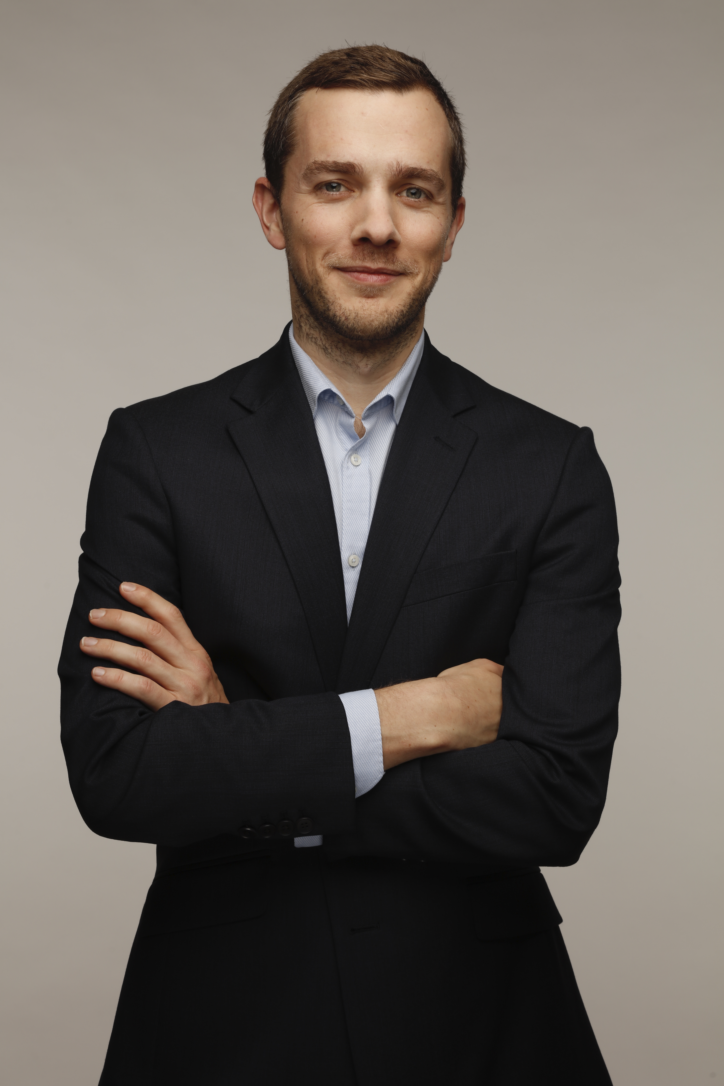
Richard Millington
@RichMillington
Community Consultant
Richard Millington is the founder of FeverBee, a community consultancy whose 310+ clients have included Apple, Facebook, Google, SAP, HP, The World Bank, Novartis, Sephora, and many more.
feverbee.com
310+
3
Communities developed
Published books
Richard has helped many of the world's largest organisations develop successful online communities.
Buzzing Communities (2012)
The Indispensable Community (2018)
Build Your Community (2021)
richard@feverbee.com

Slide 13
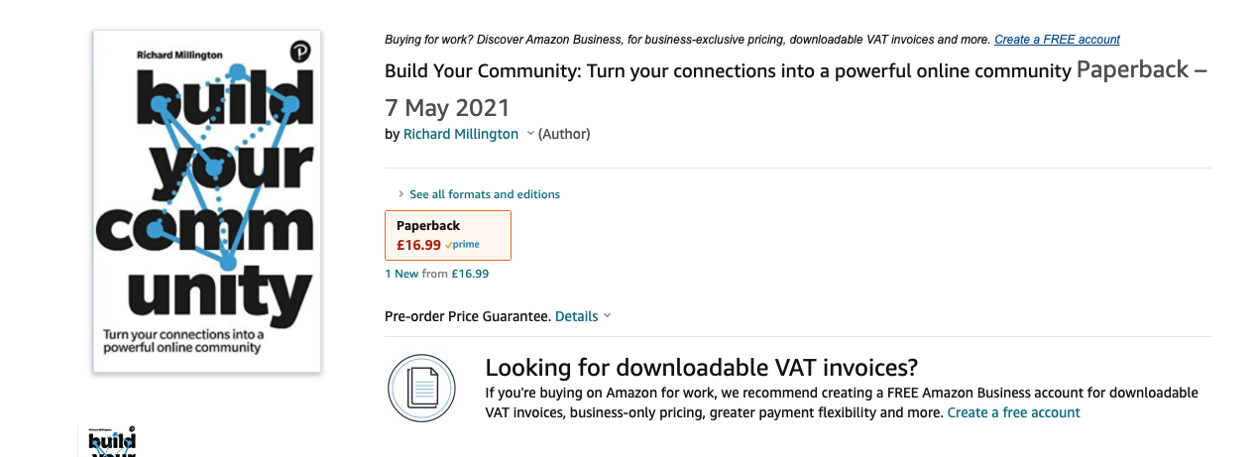
buy build your community

